Slide 1
Interim report 1 April – 30 September 2021
Niklas Stenberg, President and CEO, and Malin Enarson, CFO

Slide 2
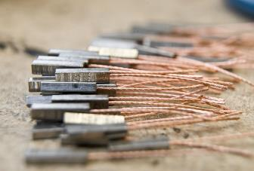
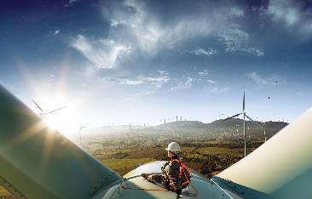
Strong quarter with high demand
Net sales
3,257 SEKm, +20%
Strong underlying demand with high activity in all business areas
Organic sales growth of 10%
EBITA growth of 39% and record high margins
Record high R/RK of 61%
Sharpened organisation from October 1st - Five areas for future growth
EBITA-margin
13.1%
From 11.2%
Notes:
It is with great pleasure I can conclude another strong quarter from Addtech.
During the quarter we increased our Net sales with 20 percent – mainly due to a strong underlying demand in all key segments and high activity in all business areas
It is very satisfying to see how well our entrepreneurs continuously handle operational challenges – right now it is component shortages, suppliers' price increases and rising transport costs.
The strong market in combination with well-handled cost inflation gave an EBITA growth of 39 percent with a record high margin to 13.1 percent. More about that within short.
In general, we expect the underlying growth to remain but settle at high levels as the market normalise. We also expect our cost levels to gradually rise as our companies increase their sales promotional activities.
Cashflow remain stable primarily thanks to our profit increase, partly offset by receivables and inventory build up for fulfilling customer demands.
During Q2 we launched our new sharpened organisation – five areas for future growth. I will come back with more details about that later in the presentation
The strong market, good cost control and well-handled cost inflation resulted in an

Slide 3
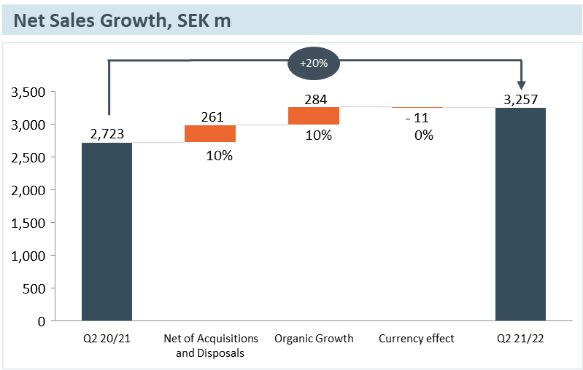
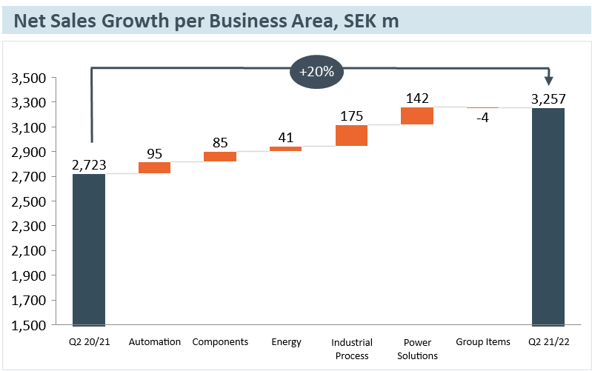
QUARTER 2: net sales development
Strong underlying demand with high growth in all business
Good growth and high acquisition rate in all business areas - net sales up with 20% of which organic growth amounted to 10%
The market situation was highly favourable in all major customer segments and geographies
  Sales of input components to manufacturing companies was fundamentally strong
  The positive trend within the forest industry, wind power and electronics remains strong
  The market for infrastructure products for rebuilding and expanding grids was good
  The low investment level in the marine sectors is unchanged while the market for electricity-related products from building and installation developed positively
Notes:
Strong underlying demand in combination with a good acquisition pace gave a sales growth of 20 percent with solid contributions from all business areas - all in all an organic increase of 10 percent. Worth mentioning here is how we were affected last year by the pandemic. We had very limited positive effects from covid-related business. Rather, we had tough situation in marine sector, mechanical industry and special vehicles where customers pulled the handbreak. If we compare to 2019, we can see that we have underlying growth in all business areas.
A lot of work has been done to make walk arounds for components and alternatives for logistics. “As one MD put it to me – it's not that there aren't components in the world. But you have to fight to get to the top of the priority list”. All in all, our conclusion is that the impact from the component shortage to a limited extent effected our output.
In general, the market situation has been highly favourable in all important segments and geographies (besides Norway). What stands out is:
Sales of input components to manufacturing companies stands out as very strong –approximately 50% of Addtechs sales are OEM business, where we generally experience a strong momentum now. Apart from some stockpiling among customers we see an increased willingness in investing again.
The positive trend for previous quarters with forestry, wind power and electronics remains
Infrastructure products for grids continues to be strong
Marine sector unchanged at low levels.
Order situation is very good, and we continue to build order stock. The extraordinary high demand situation is a mix of a backlog from last year’s projects postponed, customers taking height for long lead times but primarily an increased end customer demand. Still a good development starting this quarter.
In general, the market situation has been highly favourable in all important segments and geographies (besides Norway). What stands out is:
Sales of input components to manufacturing companies stands out as very strong – also when adjusting for stockpiling among customers: So a better willingness in investing again. All in all, approximately 50% of Addtechs sales are OEM business, and that is generally having a strong momentum now.
The positive trend for previous quarters with forestry, wind power and electronics remains
Infrastructure products for grids continues to be strong – sales were stable as expected
Marine sector unchanged at low levels. Good trend in electricity-related products

Slide 4
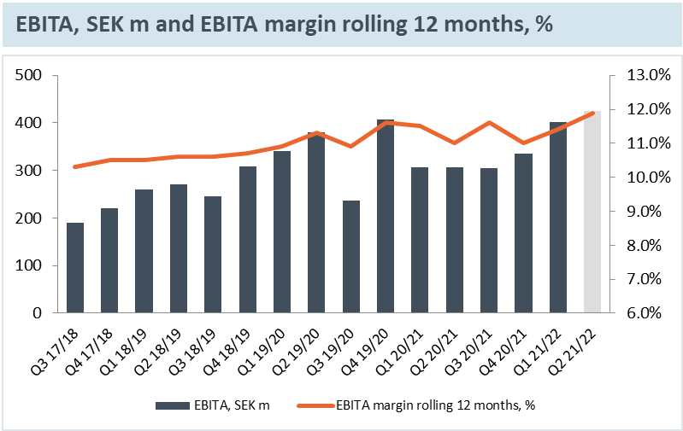
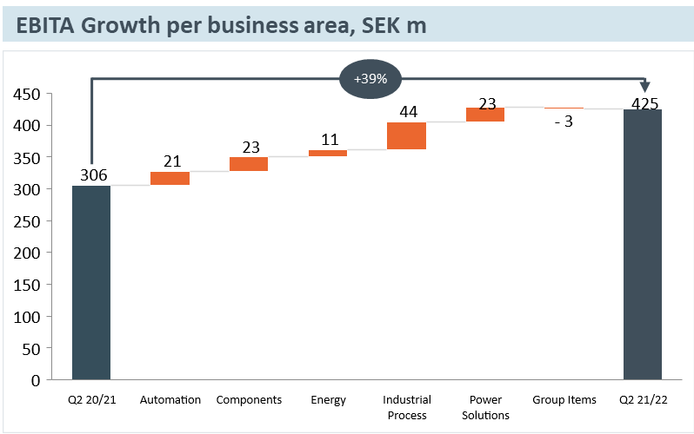
quarter 2: ebita development ebita increased 39% with record high margins
EBITA amounted to 425 MSEK (306)
Strong market situation, continued good cost control and well-handled price increases from suppliers
The record high EBITA-margin amounted to 13.1% (11.2)
Cost levels expected to gradually rise in line with promotional customer activities increases
Notes:
Our second quarter was also strong from an EBITA perspective – up 39 percent. This is both organically and complemented by acquisitions.
Besides the strong market - the fact that our cost level is still relatively low continues to be a part of the explanation. This quarter we got the full effect from the measures we took last year – just as expected. That in combination with the extraordinary job our companies is doing in relation to price inflation, have taken the margins to record levels, both in the quarter and accumulated.
The up-coming quarters we expect the cost levels to normalize when activities in sales and marketing is gradually picking up and companies are now in a forward looking mindset.
.

Slide 5




quarter 2: Business area development
HIGH ACTIVITY IN ALL BUSINESS AREAS
AUTOMATION
COMPONENTS
ENERGY
INDUSTRIAL PROCESS
POWER SOLUTIONS
Net sales 657 SEKm (562) +17%
EBITA 81 SEKm (60) +35%
EBITA-margin 12.4%
Both demand and sales were highly favourable in the engineering industry, medical technology, the defence industry, as well as data and telecom
Positive market situation in all geographies
Net sales 572 SEKm (487) +17%
EBITA 73 SEKm (50) +47%
EBITA-margin 12.7%
The market for input components remained at a very high level
Strong demand in key segments engineering industry, special vehicles, medical technology, wind power and electronics
Highly favourable market situation in Finland and Sweden, good in Denmark and stable in Norway
Net sales 674 SEKm (633) +6%
EBITA 90 SEKm (79) +15%
EBITA-margin 13.4%
The market situation in wind power remains strong
The business situation for niche products for electricity distribution, fibre-optic networks and for construction and installation remained favourable
The demand for products for grids was good – while sales were stable as expected
Net sales 855 SEKm (680) +26%
EBITA 121 SEKm (77) +57%
EBITA-margin 14.2%
For the companies exposed to the engineering industry, special vehicles and the process industry, both demand and sales developed very well
The market situation for projects in the forest and sawmill industry was very strong
Activity remained low for the companies exposed to the marine segment
Net sales 507 SEKm (365) +39%
EBITA 69 SEKm (46) +49%
EBITA-margin 13.6%
Very good growth among the companies operating in control and ergonomics products for special vehicles
Favourable market situation for the companies offering components and systems for electrification projects
Notes:
We have had a very good activity in the quarter throughout the organisation – both organic and through acquisitions. All business areas contribute with high underlying growth – also adjusted for negative Covid-effects from last year.
Some short comments on each of the business areas:
Automation – very good demand from all major segments, especially strong recovery from companies outside of Nordics where we had very tough situation last year.
If we take 2020 out of the equation, we have growth in all three business units.
Very strong margin improvement, primarily thanks to operational leverage but also supported by acquisitions.
Components – very good momentum. Components was actually quite OK last year, due to some positive covid effects in medical. Strong growth on most segments and also geographies, accept for Norway that is still slower due to low activities in oil&gas investments. Finland strong growth – we have good positions on medical and electronics markets – Denmark continues to be strong especially on windpower and Sweden has come back to steady growth.
Good effects from the efficiency measures made last year, is giving a good leverage on the margin.
Energy – tough comparisons, having a really strong quarter last year, so the quite low growth level are in line with our expectations. Building and installation market is strong for our companies here and also OEM market for electrical material. Transmission – increased inflow of projects again, which is very positive, but more affecting 2022/2023. Strong margins. All in all a very stable quarter.
Industrial Products – Looking at last year, a very tough situation with large loss on scrubber business and also mechanical industry hampered by covid. Now it looks very strong again. Basically, most segments are strong, except for marine segment. Not only scrubber, still on a low level, but also marine in general – however, a little bit positive signals for aftermarket and service now when we can board the ships again. Sawmill market still very positive momentum. Even if record high prices on sawd timber nas come down a bit there is still a strong investment climate on the market. Margin on a strong level, both good contributions from acquisitions but also good leverage on the sales volumes.
Power Solutions – Also here a very tough situation last year. Special vehicles – biggest customer segment – loosing 30% volume last year. Now that market is back on growth figures compared to 2019 and a good sentiment.
Battery systems – stood up good last year, having a good growth now. Issues with long leadtimes (more than a years leadtime on some cells) which means some inventory build up. All costs are not back to normal level, and if we take into account a resterucuring cost, the margins are on a high level.

Slide 6
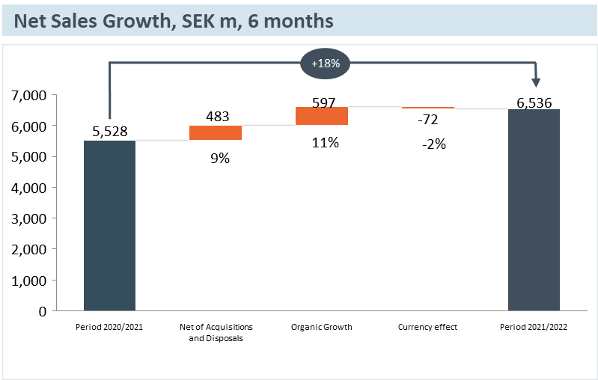
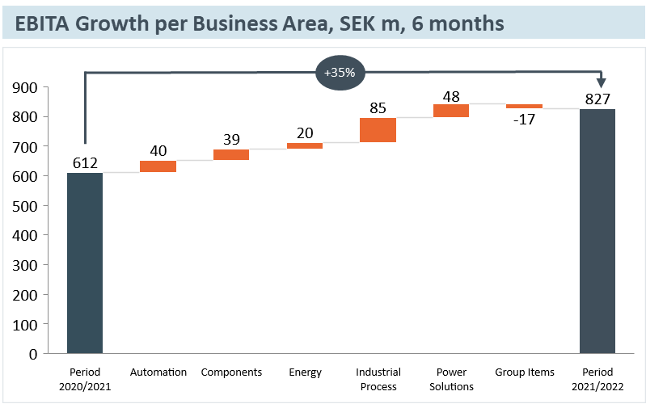
period April 1 – September 30 net sales Increased by 18 %
Net sales increased by 18% to SEK 6,536 m (5,528)
The organic growth amounted to 11 percent and acquired growth amounted to 9 percent
EBITA increased by 35% and amounted to SEK 827 m (612) corresponding to an EBITA margin of 12.7% (11.1)
Operating profit increased by 41% and amounted to SEK 683 m (485) corresponding to an operating margin of 10.4% (8.8)
Profit after tax increased by 40% and amounted to SEK 513 m (365)
Earnings per share before dilution amounted to SEK 1.85 (1.30)
Cash flow from operating activities amounted to SEK 435 m (567)

Slide 7





Carefully selected acquisitions
5 acquisitions in the second quarter
365 SEKm
Total annual turnover
98
New employees
Acquisition activity at high level in all business areas
11 companies acquired since the beginning of the financial year – adding an annual turnover of 840 SEKm and 238 new colleagues
 | Acquisition | Business area | Access | Net sales, MSEK* | Employees*
 | ESi Controls Ltd. | Power Solutions | April 2021 | 95 | 15
 | Hydro-Material Oy | Components | April 2021 | 50 | 5
 | IETV Elektroteknik AB | Energy | May 2021 | 80 | 38
 | AVT Industriteknik AB | Automation | May 2021 | 70 | 42
 | EK Power Solutions AB | Components | July 2021 | 40 | 25
 | KZ moder AB | Industrial Process | July 2021 | 100 | 29
 | Finnchain Oy | Industrial Process | July 2021 | 70 | 20
 | Tritech Solutions AB | Automation | August 2021 | 60 | 8
 | Systerra Computer GmbH | Automation | September 2021 | 95 | 16
 | ABH Stromschienen GmbH | Electrification | October 2021 | 100 | 22
 | Ko Hartog Verkeerstechniek B.V. | Energy | October 2021 | 80 | 18
*Refers to assessed situation on a full-year basis at the time of acquisition
Notes:
The acquisition pace continues. 5 carefully selected companies acquired during the quarter, two more signed after the end of the period. In total that adds up to 11 companies during the financial year so far.
Several of the acquisitions have a clear sustainability profile and we continue to expand outside the Nordic region, in line with our acquisition strategy. As you can see, the last three acquisitions we had two in Germany and one in Netherlands, so our increased activities are bearing fruit here. With our financial strength and attractive acquisition pipeline, we perceive favourable opportunities for maintaining a good acquisition rate. Many privately owned companies want to sell to Addtech to maintain their decentralised responsibility while receiving development support from an active, long-term owner and gaining access to relevant networks.

Slide 8
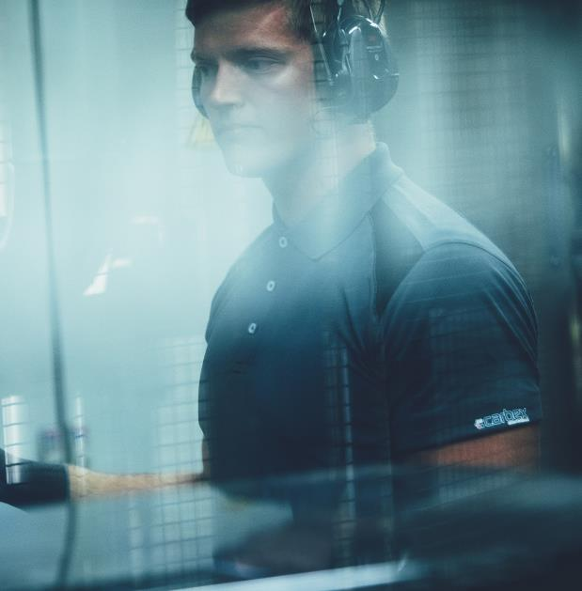
FINANCIAL POSITION

Slide 9
INCOME STATEMENT, CONDENSED

Slide 10
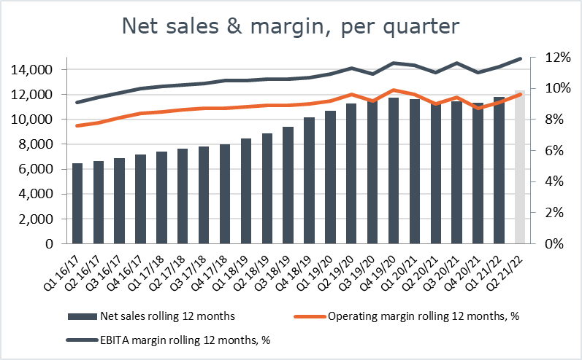
Net sales & margin
30/9 2021 R12
Net Sales | 12,344 kSEK
EBITA | 1,466 kSEK
EBITA margin | 11.9 %
Operating profit | 1,187 kSEK
Operating margin | 9.6 %

Slide 11
CASH FLOW STATEMENT, CONDENSED

Slide 12
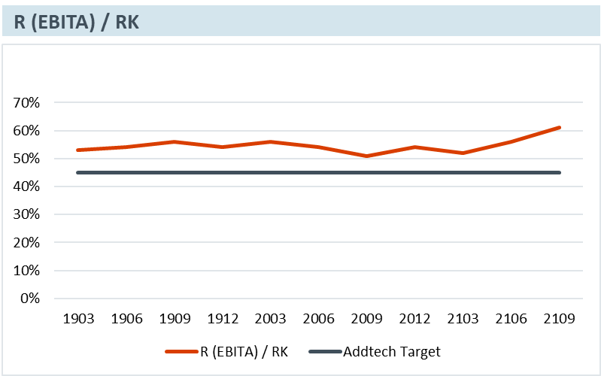
P (ebita) / WC
Record high P/WC 61%
  Positive effect from improved margins and EBITA
  Negative effects from necessary working capital increases

Slide 13
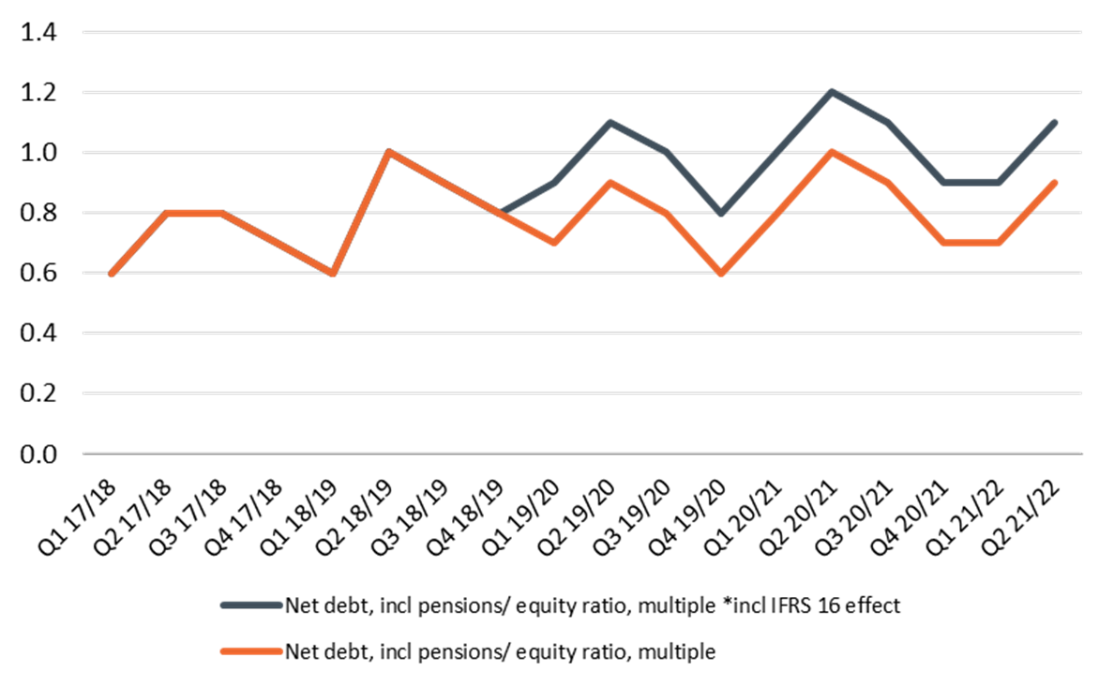
KEY FINANCIAL INDICATORS
Back to satisfactory levels of key ratios despite high acquisition pace and dividend
  Equity ratio 32% (32%)
  Leverage 2.2 (2.4)
  Gearing 1.1 (1.2)

Slide 14
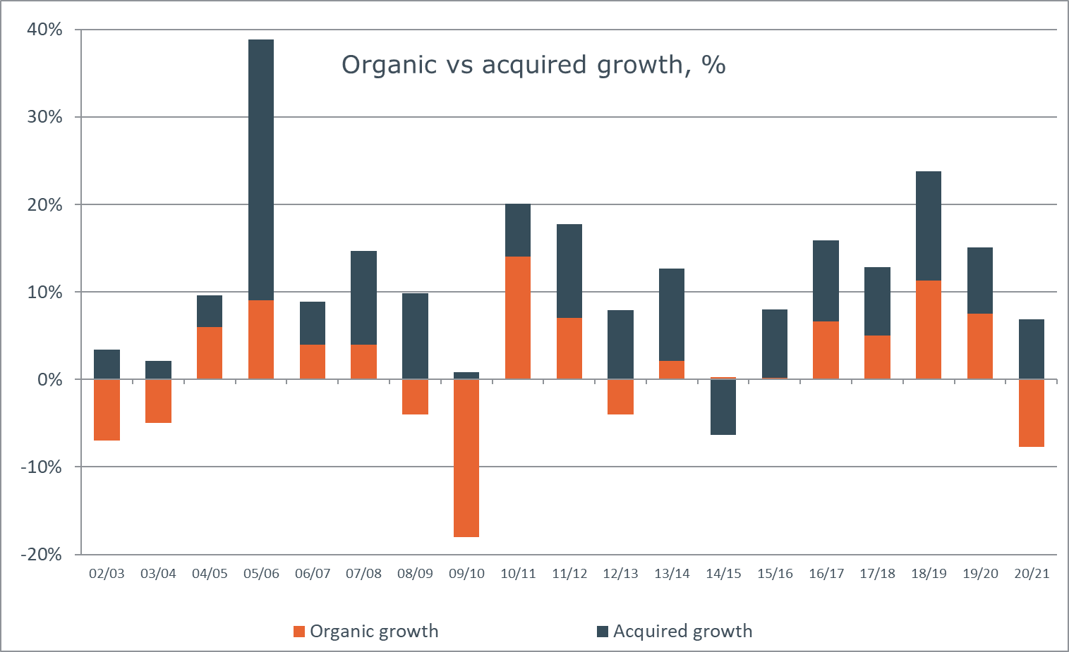
strategic mix for sustainable growth
Notes:
One of the key success factors over the last 20 years is the strategic mix between organic and acquired growth.
By acquiring, only carefully selected companies, with a perfect cultural fit we can secure a long-term sustainable growth.
We complement our effective and strategic acquisition model with active ownership where we leave all operational decisions to our entrepreneurs.
We strongly believe that the best decision are made close to the market. This business model has this quarter once again proved it’s strength.
Our companies continue to foster optimum conditions for sustained profitable growth.
Förutom X Y Z så har vi haft organisk tillväxt. Ett par procent bättre än industriell tillväxt.. Visar att vi vår modell funkar…. MEN VAD BIDRAR VI MED….?

Slide 15

















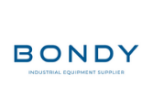






























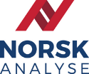

































































Adding passion for people and entrepreneurship
FINANCIAL STRENGTH
ACADEMY
GROUP FUNCTIONS
CULTURE
STRATEGY
CORE VALUES
SUSTAINABILITY
ACQUISITION MODEL
NETWORK
ACTIVE OWNERSHIP
TALENT MANAGEMENT
Notes:
For Addtech the companies are the heroes! If they feel “powered by Addtech” we have succeeded. To secure that the entrepreneurs only have their eyes on the business we support them in various areas that are more effectively run centrally. Besides that, Addtech only add a passion for entrepreneurship and a network for growth. The network is one important key for the companies through co-creation take their business to the next level.
This is what differs Addtech from others!

Slide 16
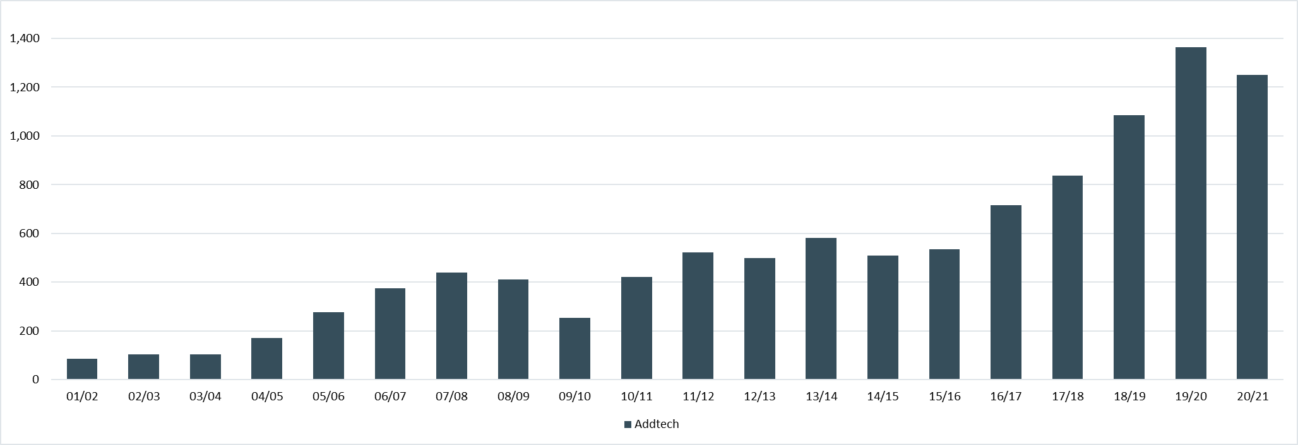
SOLID TRACK RECORD of ebita growth
CAGR 18%
9/11, IT crisis
Finance crisis
Oil crisis
Cyber attack
Covid-19
Notes:
Our business model is more than a hundred years and well proven.
This autumn we celebrate 20 years as a listed company. When summarising we can proudly report an average annual profit growth of 18 percent. Well above our own ambitious target of 15 percent.
One key success factor is that we are never satisfied and constantly adjust and sharpens our set-up

Slide 17



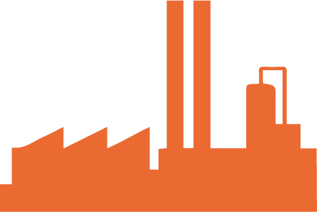

Five areas for FUTURE growth
AUTOMATION
ENERGY
ELECTRIFICATION
INDUSTRIAL SOLUTIONS
PROCESS TECHNOLOGY
MOTION & DRIVES
BATTERY SYSTEMS
ENERGY
PRODUCTS
MATERIAL PROCESSING
PROCESS
SYSTEMS
INDUSTRIAL IT
& SENSORS
CONNECTIVITY SOLUTIONS
ENERGY
SUPPLY
VEHICLE
SOLUTIONS
EMISSION CONTROL
POWER & MOBILITY
PROCESS CONTROL
Industry 4.0
Smart cities
Internet of Things
Decarbonisation
Energy storage - batteries
Increased production of renewable energy
Grid development
Safety products
Resource efficiency – recycling systems
Increased focus on ergonomy
Increased use of fibre-based materials
Increased regulations – emissions air and water
Efficiency and optimisation of industrial flows
Notes:
From 1 October we have a sharpened organisation – five business areas with clear niche-strategies to leverage on our unique position.
Bottom line the changes are undramatic – re-clustering our companies is something we do periodically in order to improve and secure our network for growth.
Our unique culture and the entrepreneurial focus is of course always unchanged!!
So - what is that we have done!? Without changing our foundation, we have made the organisational set-up clearer and more efficient. In practice this means that all business areas now knows exactly what pockets of growth they are aiming to capture. How they should leverage on the potential…and finally, we put the right people to execute on our high ambitions.
Clear growth driver for each BA
Automation - is set to capture the potential in strong driving forces, such as Industry 4.0, intelligent cities and the Industrial Internet of Things (IIOT).
Electrification - has a clear ambition to be a driver towards a fossil free future by providing solutions for electrification making equipment more productive, connected and powerful
Energy - has their focus on generate profitable growth from society's ongoing transition towards CO2 neutrality. With a strong positions in electricity transmission, wind power and distribution networks they are one of the key enablers to make it happen. BA Energy is The business area will also continue to invest in the intelligent homes niche, as well as in public safety.
Industrial Solutions – the strategy is to capturing the potential of sustainable technology solutions that mitigate society’s environmental impact. Waste and recycling systems, ergonomic products and solutions linked to the increased use of wood are all clear areas for future growth.
Process Technology - target the growth potential in increased demand for a sustainable transformation of the process- and marine industry - particularly in terms of emissions to both water and air. With a growing need for technical solutions that control and analyse various industrial processes, the BA perceive continued favourable opportunities for growth
Our niche strategies have been sharpened to enhance clarity, both internally as well as towards the acquisition and capital markets, and to seize future growth potential more effectively, both organically and through acquisitions.

Slide 18
Summary
Strong underlying demand with high activity in all business areas
  Net sales increased with 20% of which 10% organic growth
  Limited effect from component shortage
  High acquisition pace remains – eleven acquisitions completed so far this financial year
EBITA growth of 39% with record high margins
  Strong market, good cost control and well-handled cost inflation by the companies
Sharpened organisation from October 1st
  Clear and efficient organisational structure to capture future growth
  Our unique culture and the entrepreneurial focus remains
Outlook
  The strong underlying demand is expected to stabilise at high levels as supply chains normalise
  Cost base expected to increase in the upcoming quarters as sales promotion activities are intensified
  Uncertainty remains as to how any further supply chain disruptions may affect our companies

Slide 19

Q&A

